Slide 1

Module 1
Regularization
Notes:
Guidelines
Use section headers to chunk content in your presentation.
Use the same style of section header throughout your presentation.
Keep your title to no more than 2 lines.

Slide 2
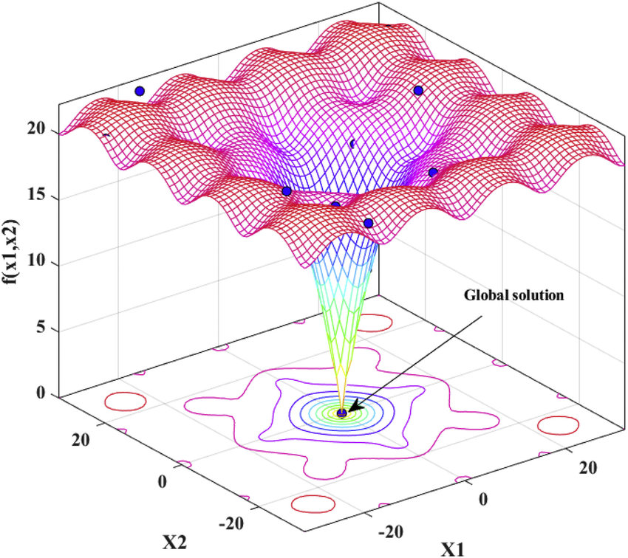
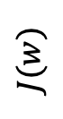
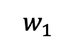
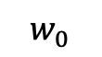
Regularization
$$J(w)$$
$$w_{0}$$
$$w_{1}$$
Notes:
Guidelines
Use a title slide at the beginning of your presentation. There are 9 variations of title slides to choose from.
If you will have a series of slideshows, we recommend using the same style of title slide for each presentation.
Keep your title to no more than 2 lines.
Do not change the font style or font size of the title or subtitle.

Slide 3
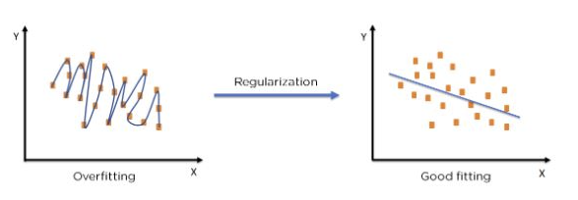
Regularization
Regularization is a set of techniques used in ML to improve a model's ability to generalize to new data.
Cost Function Penalties (linear models + gradient boosting)
Pruning (trees)
Dropout + Cost Function Penalties (neural networks)

Slide 4
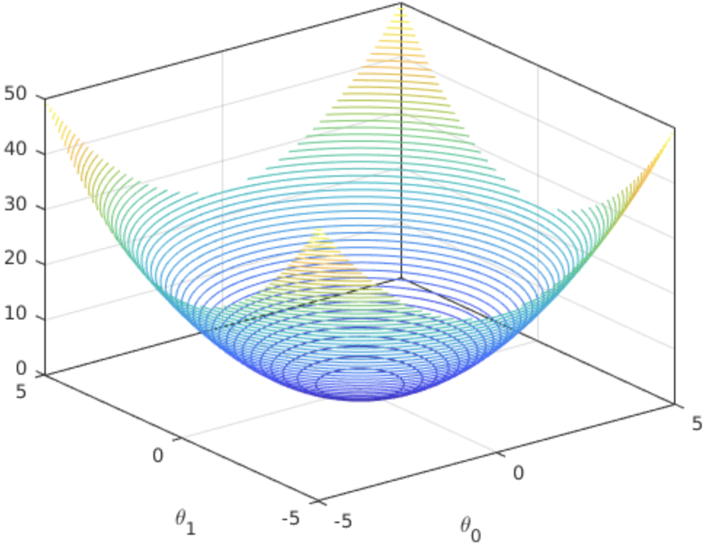
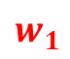


Linear Regression Cost Function
E.g., for linear regression, the cost function is convex:
$$J\left(w\right)={\left(y−Xw\right)}^{⊤}\left(y−Xw\right)={\left\|y−Xw\right\|}_{2}^{2}$$
$$J(w)$$
Global minimum
$$w_{0}$$
$$w_{1}$$

Slide 5
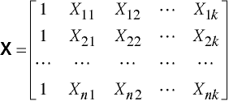
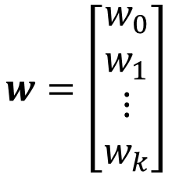
Linear Regression Cost Function
E.g., for linear regression, the cost function is convex:
$$J\left(w\right)={\left(y−Xw\right)}^{⊤}\left(y−Xw\right)={\left\|y−Xw\right\|}_{2}^{2}$$
$$w=\left[\begin{matrix}w_{0} \\ w_{1} \\ \begin{aligned}⋮ \\ w_{k}\end{aligned}\end{matrix}\right]$$
$$J(w)$$
Global minimum
$$w_{0}$$
$$w_{1}$$
We focus on regularizing (controlling) the weights

Slide 6
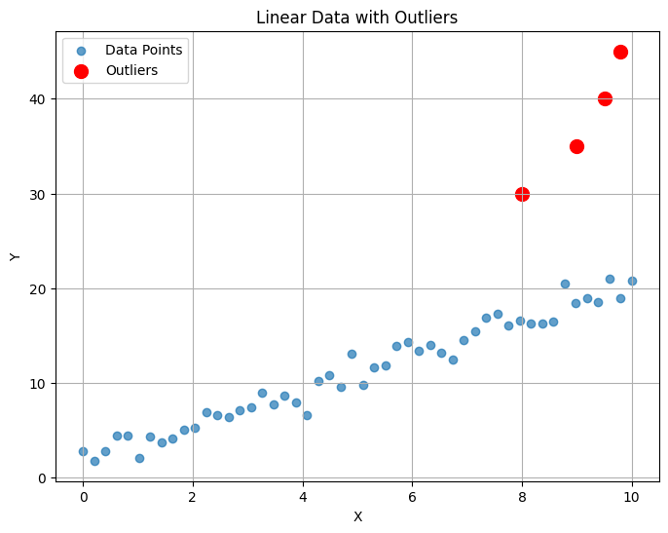
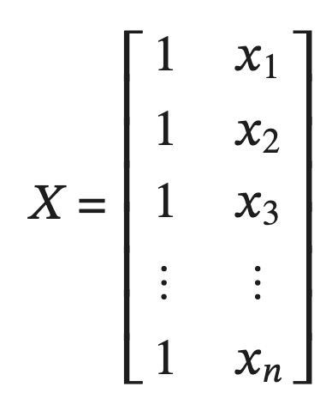
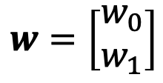
Linear Regression Cost Function
E.g., for linear regression, the cost function is convex:
$$J\left(w\right)={\left(y−Xw\right)}^{⊤}\left(y−Xw\right)={\left\|y−Xw\right\|}_{2}^{2}$$
$$w=\left[\begin{matrix}w_{0} \\ w_{1}\end{matrix}\right]$$
We focus on regularizing (controlling) the weights

Slide 7
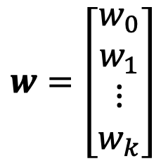
Linear Regression Cost Function
E.g., for linear regression, the cost function is convex:
$$J\left(w\right)={\left(y−Xw\right)}^{⊤}\left(y−Xw\right)={\left\|y−Xw\right\|}_{2}^{2}$$
$$w=\left[\begin{matrix}w_{0} \\ w_{1} \\ \begin{aligned}⋮ \\ w_{k}\end{aligned}\end{matrix}\right]$$
We focus on regularizing (controlling) the weights

Slide 8
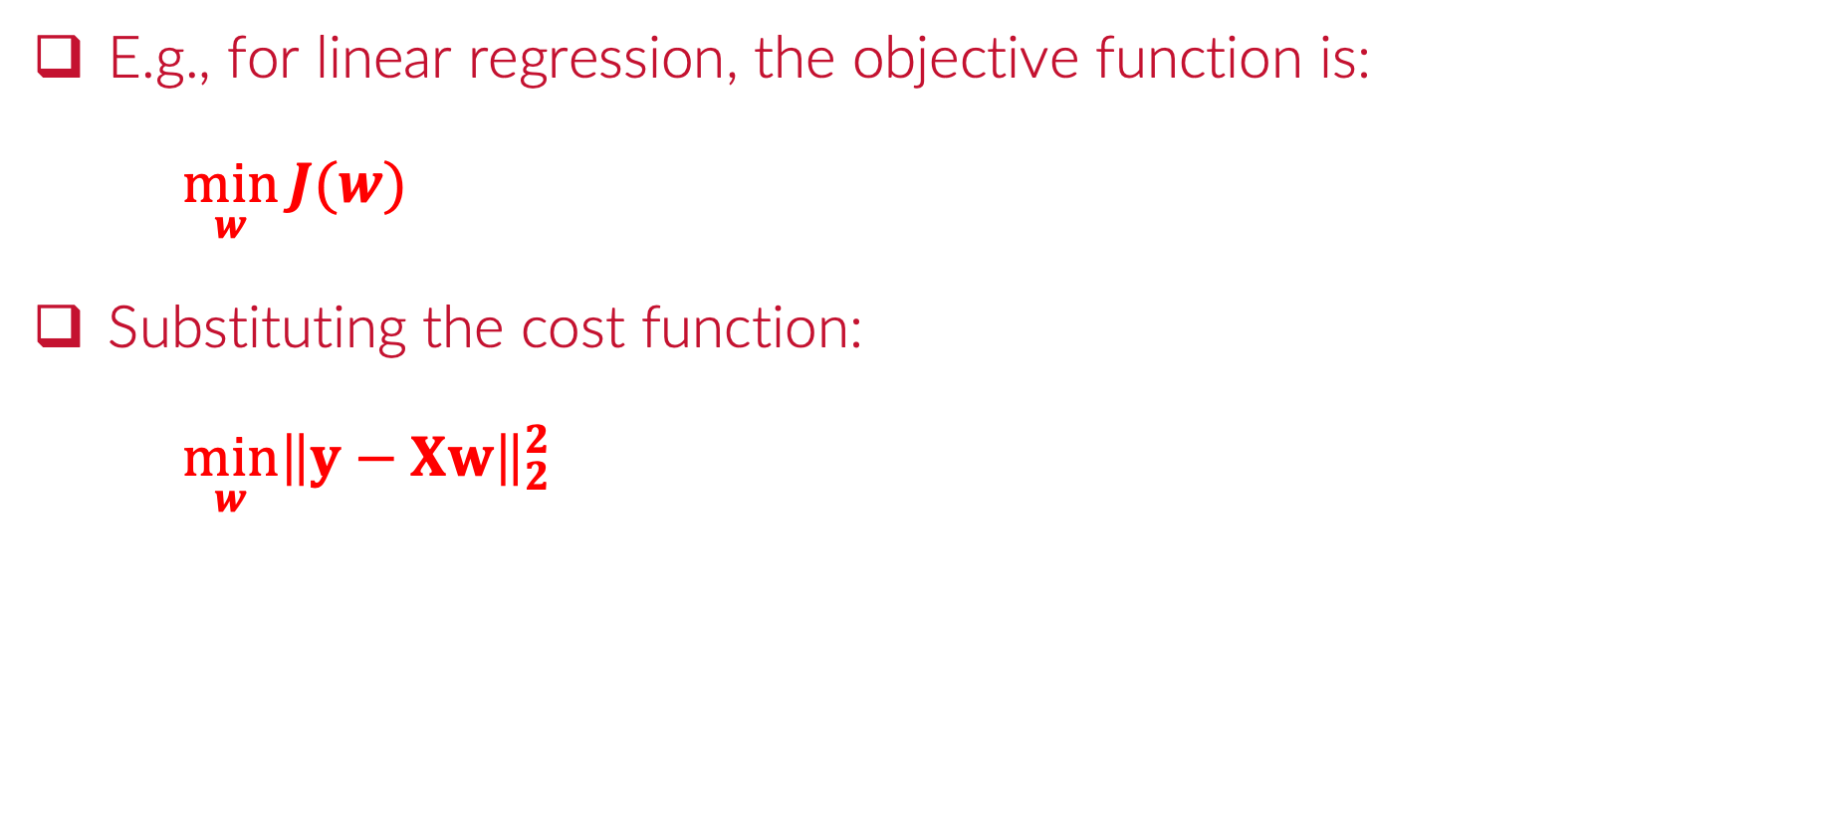
Linear Regression Cost Function
E.g., for linear regression, the objective function is:
$\min_{w}{J(w)}$
Substituting the cost function:
$\min_{w}{{\left\|y−Xw\right\|}_{2}^{2}}$

Slide 9
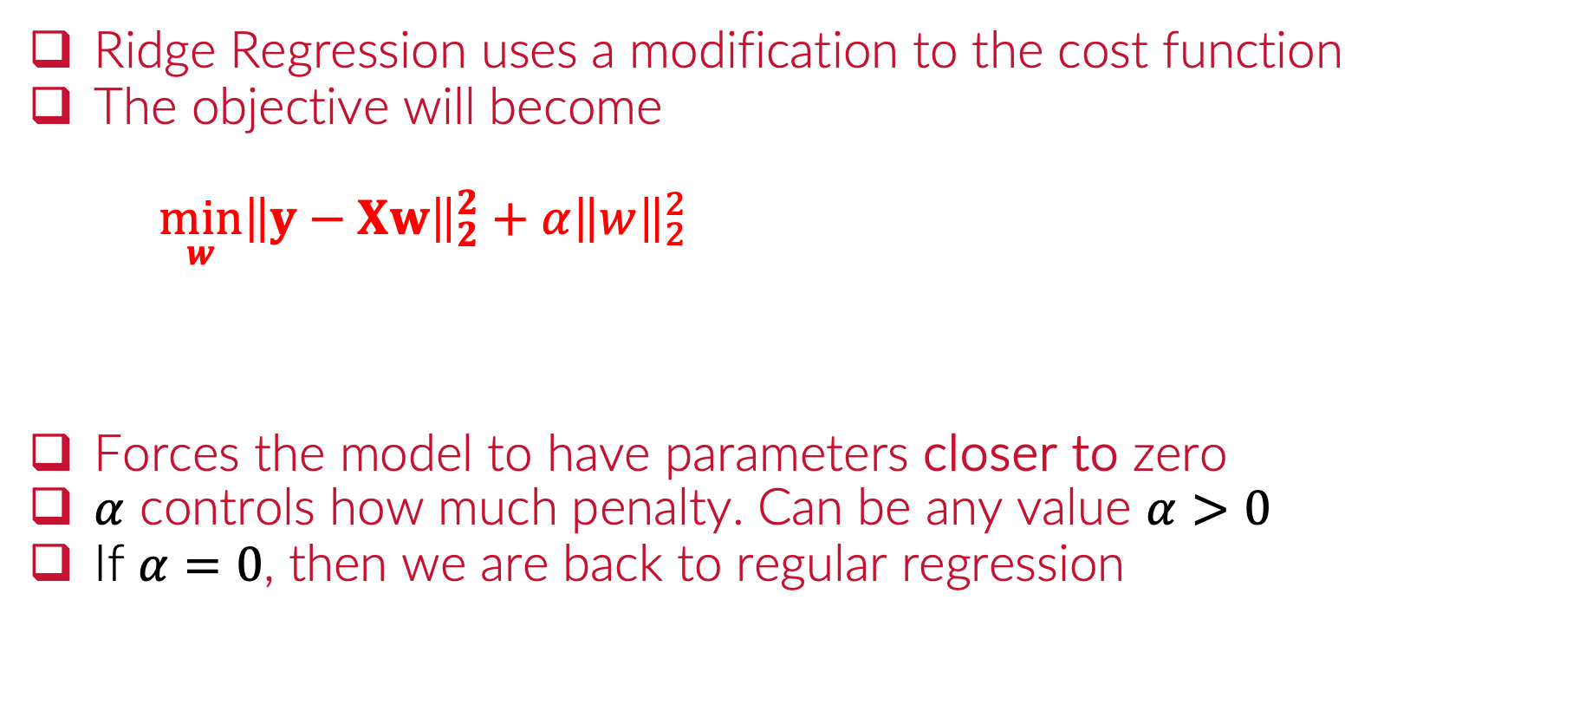
Ridge Regression - Adding an L₂ Penalty
Ridge Regression uses a modification to the cost function
The objective will become
$\min_{w}{{\left\|y−Xw\right\|}_{2}^{2}}+α{\left\|w\right\|}_{2}^{2}$
Forces the model to have parameters closer to zero
$α$ controls how much penalty. Can be any value $α>0$
If $α=0$, then we are back to regular regression
L2 penalty

Slide 10
Python
Notes:
Guidelines
Use a title slide at the beginning of your presentation. There are 9 variations of title slides to choose from.
If you will have a series of slideshows, we recommend using the same style of title slide for each presentation.
Keep your title to no more than 2 lines.
Do not change the font style or font size of the title or subtitle.

Slide 11
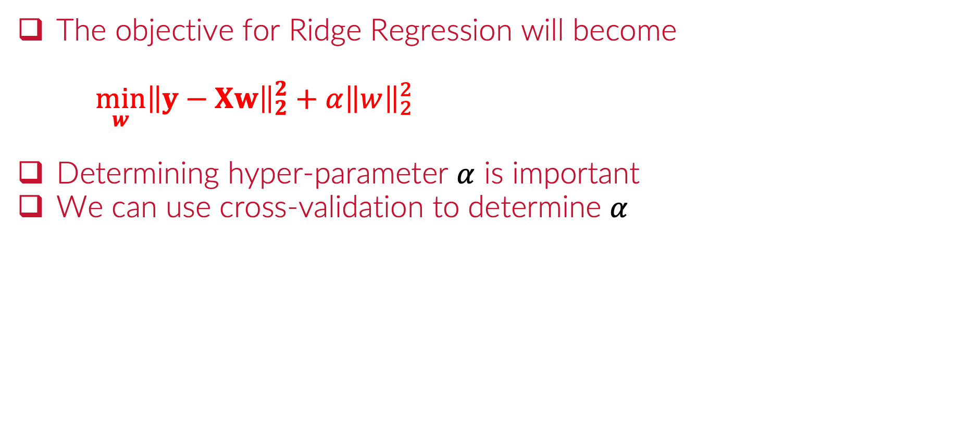
Ridge Regression with Cross-Validation
The objective for Ridge Regression will become
$\min_{w}{{\left\|y−Xw\right\|}_{2}^{2}}+α{\left\|w\right\|}_{2}^{2}$
Determining hyper-parameter $α$ is important
We can use cross-validation to determine $α$
L2 penalty

Slide 12
Python
Notes:
Guidelines
Use a title slide at the beginning of your presentation. There are 9 variations of title slides to choose from.
If you will have a series of slideshows, we recommend using the same style of title slide for each presentation.
Keep your title to no more than 2 lines.
Do not change the font style or font size of the title or subtitle.

Slide 13
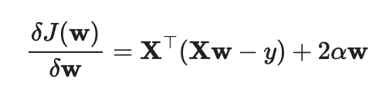
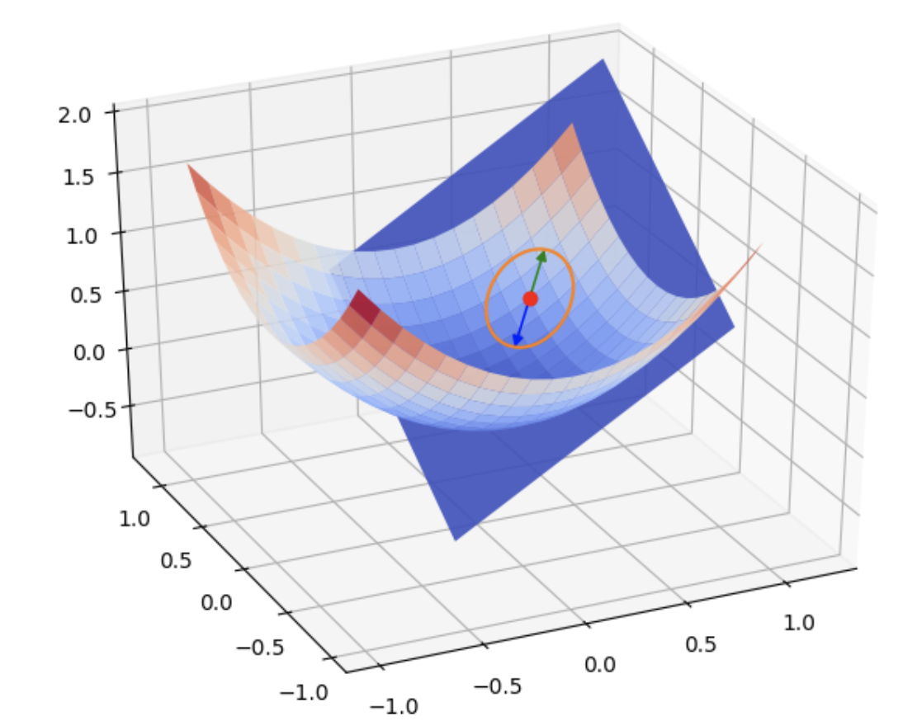
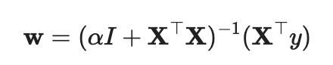
Ridge Regression Gradient
The gradient for Ridge Regression is:
The cost function is still convex (FAST COMPUTATIONALLY)
The minimum can be found with the formula below:

Slide 14
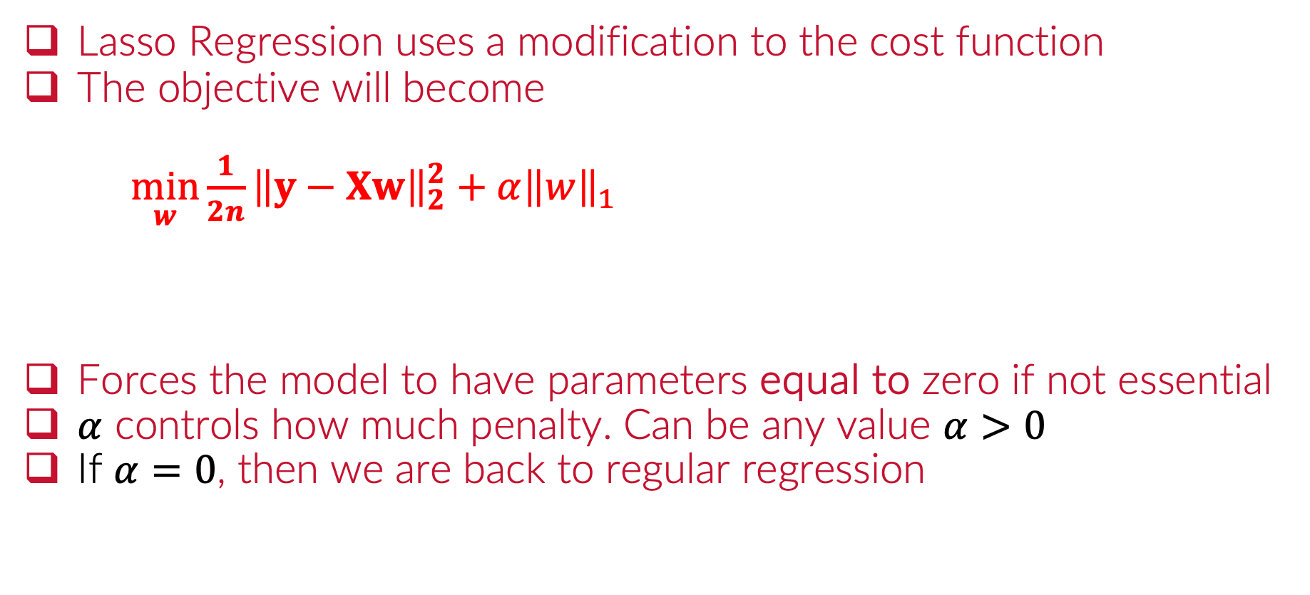
Lasso Regression - Adding an L₁ Penalty
Lasso Regression uses a modification to the cost function
The objective will become
$\min_{w}{{\frac{1}{2n}\left\|y−Xw\right\|}_{2}^{2}}+α{\left\|w\right\|}_{1}$
Forces the model to have parameters equal to zero if not essential
$α$ controls how much penalty. Can be any value $α>0$
If $α=0$, then we are back to regular regression
L1 penalty

Slide 15
Python
Notes:
Guidelines
Use a title slide at the beginning of your presentation. There are 9 variations of title slides to choose from.
If you will have a series of slideshows, we recommend using the same style of title slide for each presentation.
Keep your title to no more than 2 lines.
Do not change the font style or font size of the title or subtitle.

Slide 16
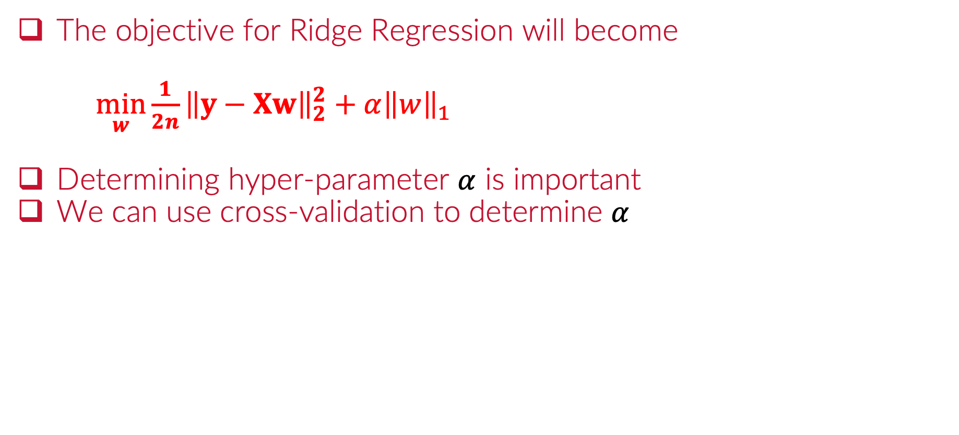
Lasso Regression with Cross-Validation
The objective for Ridge Regression will become
$\min_{w}{{\frac{1}{2n}\left\|y−Xw\right\|}_{2}^{2}}+α{\left\|w\right\|}_{1}$
Determining hyper-parameter $α$ is important
We can use cross-validation to determine $α$
L1 penalty

Slide 17
Python
Notes:
Guidelines
Use a title slide at the beginning of your presentation. There are 9 variations of title slides to choose from.
If you will have a series of slideshows, we recommend using the same style of title slide for each presentation.
Keep your title to no more than 2 lines.
Do not change the font style or font size of the title or subtitle.

Slide 18
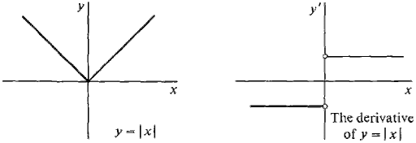
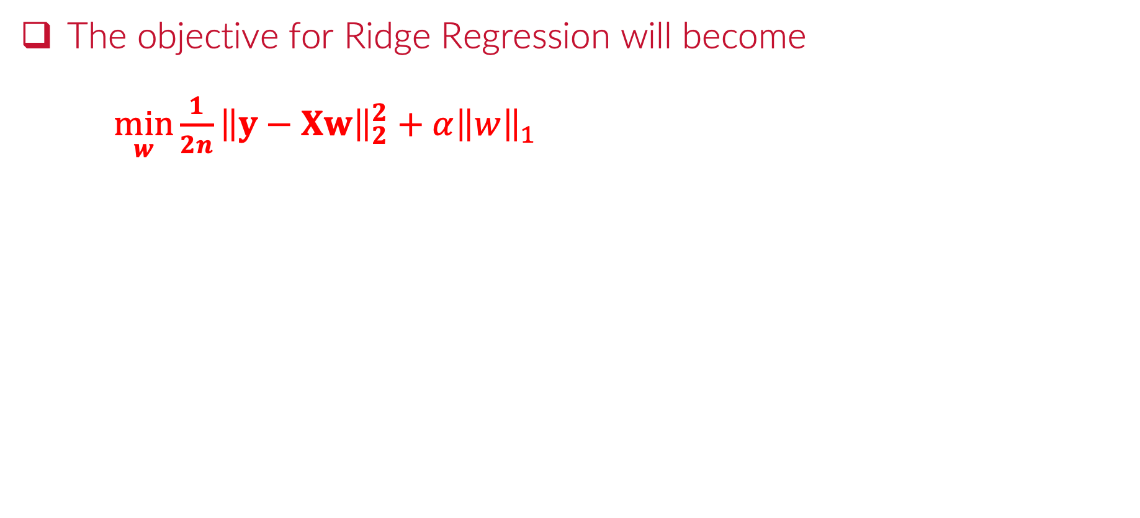
Lasso Regression with Cross-Validation
The objective for Ridge Regression will become
$\min_{w}{{\frac{1}{2n}\left\|y−Xw\right\|}_{2}^{2}}+α{\left\|w\right\|}_{1}$
L1 penalty

Slide 19
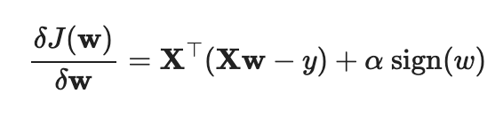
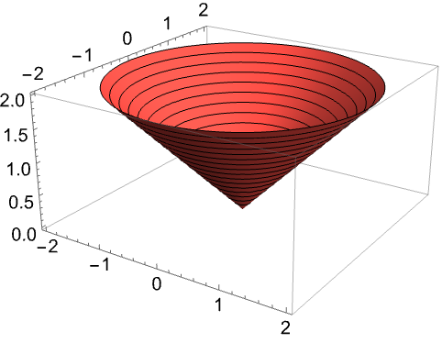
Lasso Regression Gradient
The gradient for Ridge Regression does not exist at zero:
The cost function is not strictly convex
We use coordinate descent and optimization to obtain minimum

Slide 20
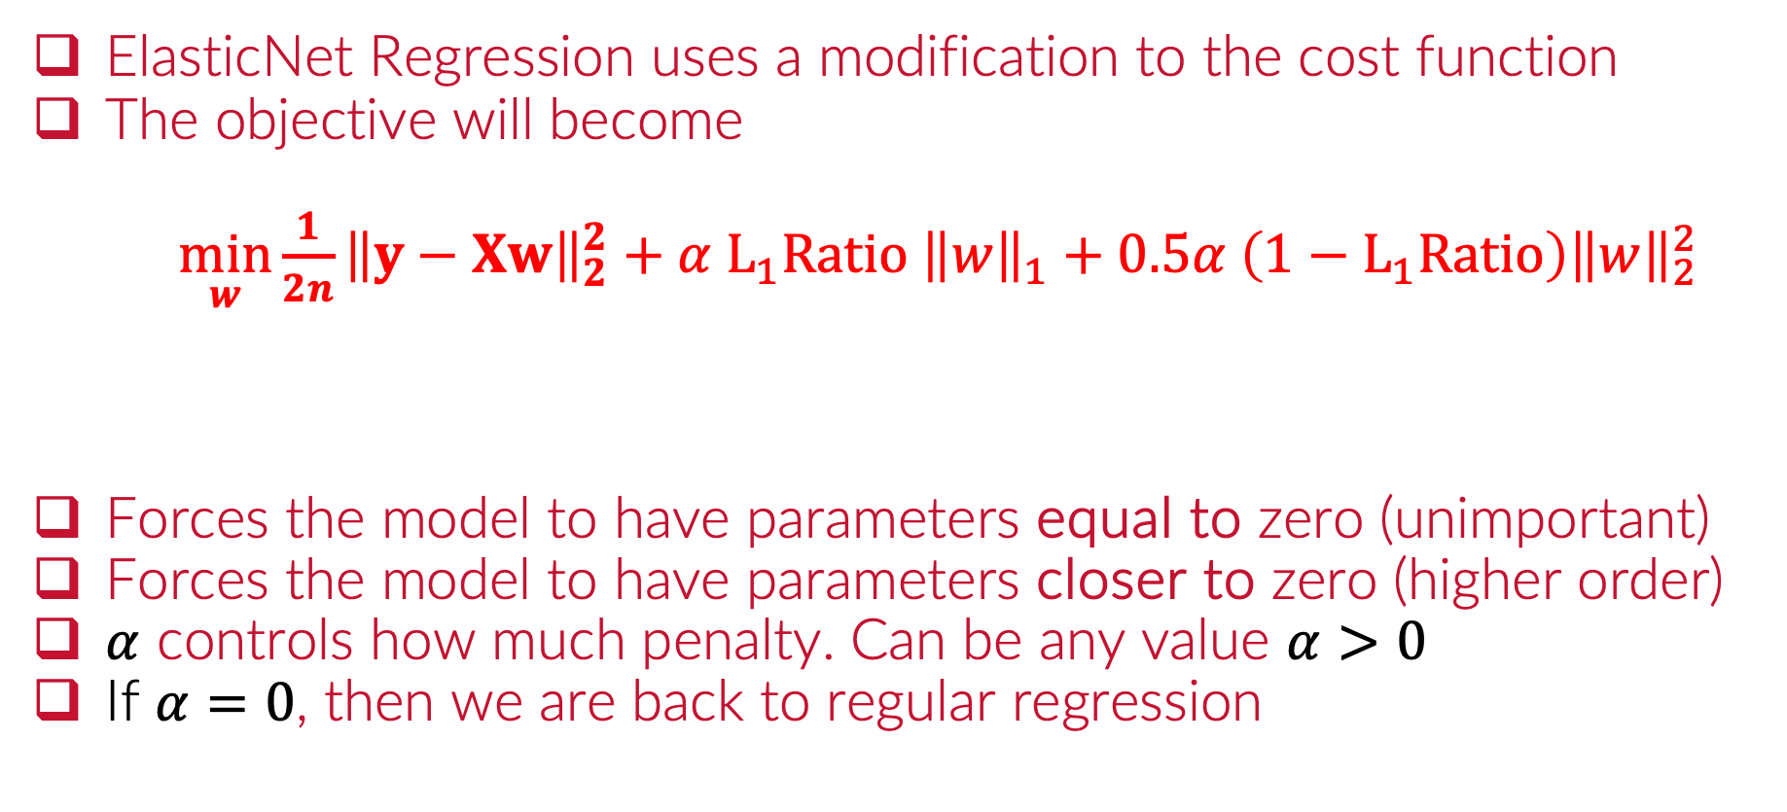
ElasticNet Regression - L₁ and L₂ Penalty
ElasticNet Regression uses a modification to the cost function
The objective will become
$\min_{w}{{\frac{1}{2n}\left\|y−Xw\right\|}_{2}^{2}}+α L_{1}Ratio {\left\|w\right\|}_{1}+0.5α \left(1−L_{1}Ratio\right){\left\|w\right\|}_{2}^{2}$
Forces the model to have parameters equal to zero (unimportant)
Forces the model to have parameters closer to zero (higher order)
$α$ controls how much penalty. Can be any value $α>0$
If $α=0$, then we are back to regular regression
L1 and L2 penalties

Slide 21
Python
Notes:
Guidelines
Use a title slide at the beginning of your presentation. There are 9 variations of title slides to choose from.
If you will have a series of slideshows, we recommend using the same style of title slide for each presentation.
Keep your title to no more than 2 lines.
Do not change the font style or font size of the title or subtitle.

Slide 22
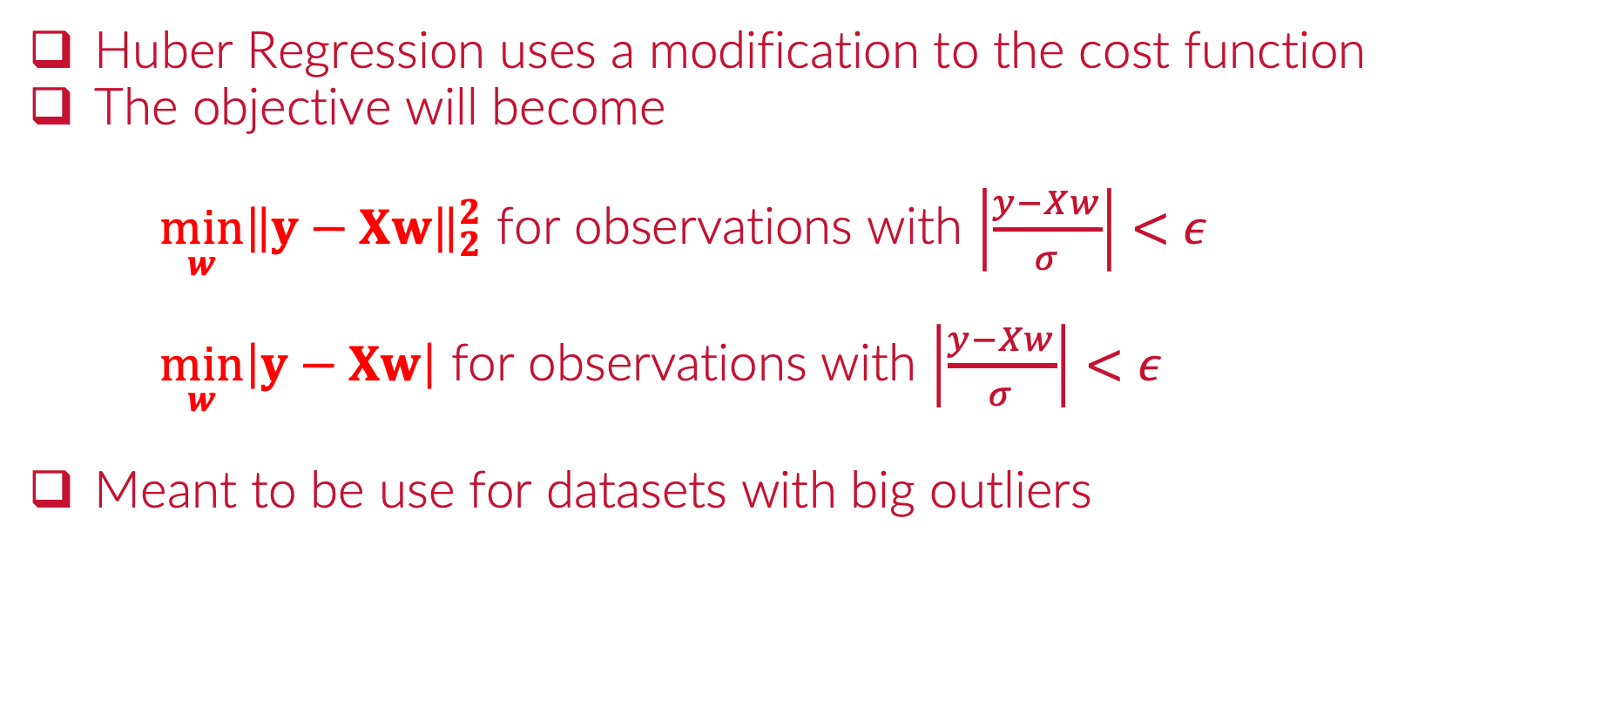
Huber Regression
Huber Regression uses a modification to the cost function
The objective will become
$\min_{w}{{\left\|y−Xw\right\|}_{2}^{2}}$ for observations with $\left|\frac{y−Xw}{σ}\right|<ε$
$\min_{w}\left|y−Xw\right|$ for observations with $\left|\frac{y−Xw}{σ}\right|<ε$
Meant to be use for datasets with big outliers

Slide 23
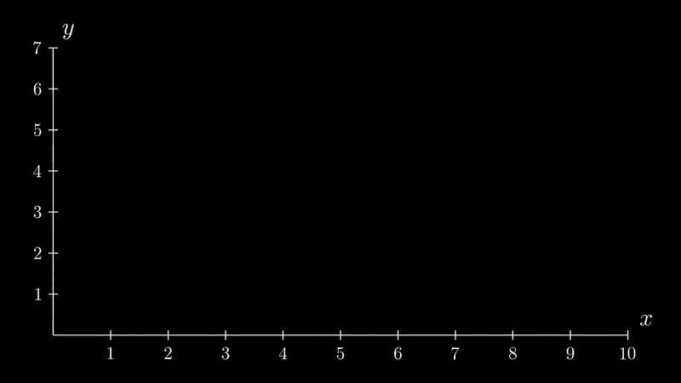
Huber Regression

Slide 24
Python
Notes:
Guidelines
Use a title slide at the beginning of your presentation. There are 9 variations of title slides to choose from.
If you will have a series of slideshows, we recommend using the same style of title slide for each presentation.
Keep your title to no more than 2 lines.
Do not change the font style or font size of the title or subtitle.

